Slide 1
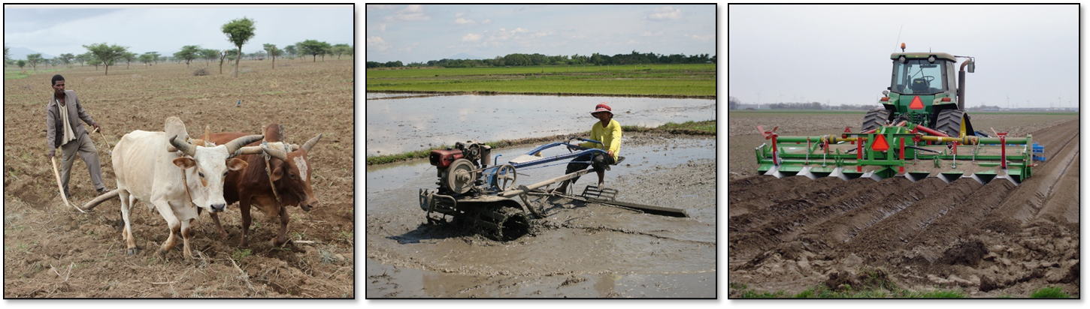
Data requirements for yield gap analysis
João Vasco Silva (PhD)
j.silva@cgiar.org
Agronomy-at-scale Data Scientist
CIMMYT-Zimbabwe
Addis Ababa, May 23rd 2023

Slide 2
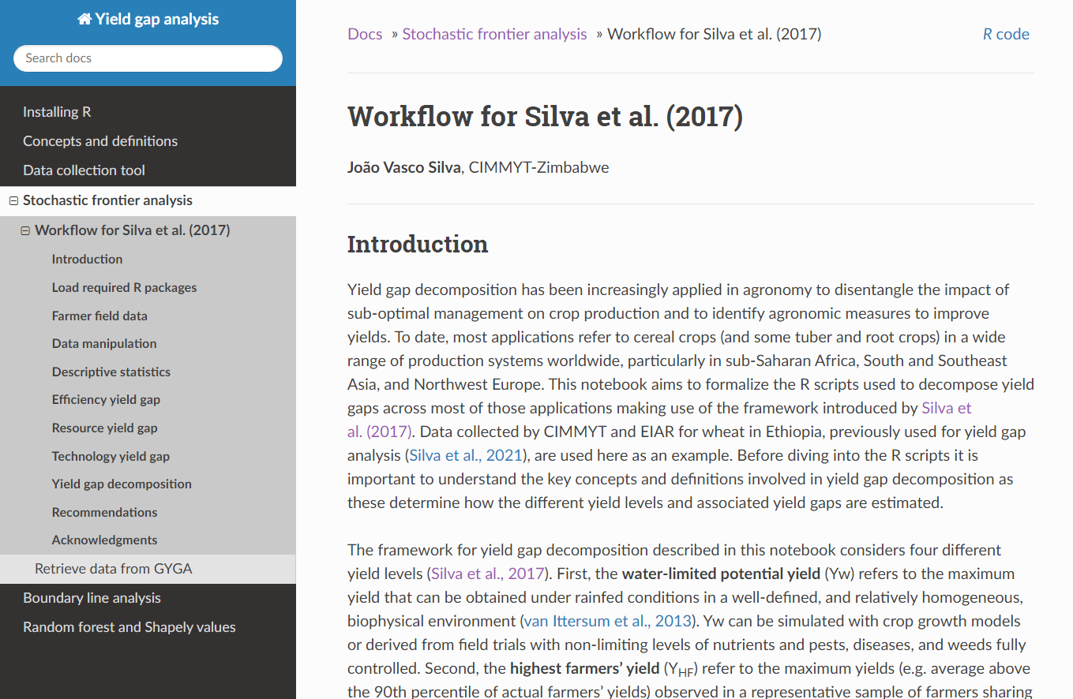
https://jvasco323.github.io/eia-yg-training

Slide 3
Minimum data requirements
Delineation of relevant biophysical units to ensure differences between farm/field performance are only attributed to management practices.
Farmer field data to estimate Ya, Y_{TEx} and Y_{HF}, and associated efficiency and resource yield gaps.
Stochastic frontier analysis
Actual yield percentiles
What were the reasons behind the selection of these sites?
(Simulated) yield ceilings from crop growth simulation models to estimate technology yield gaps.

Slide 4
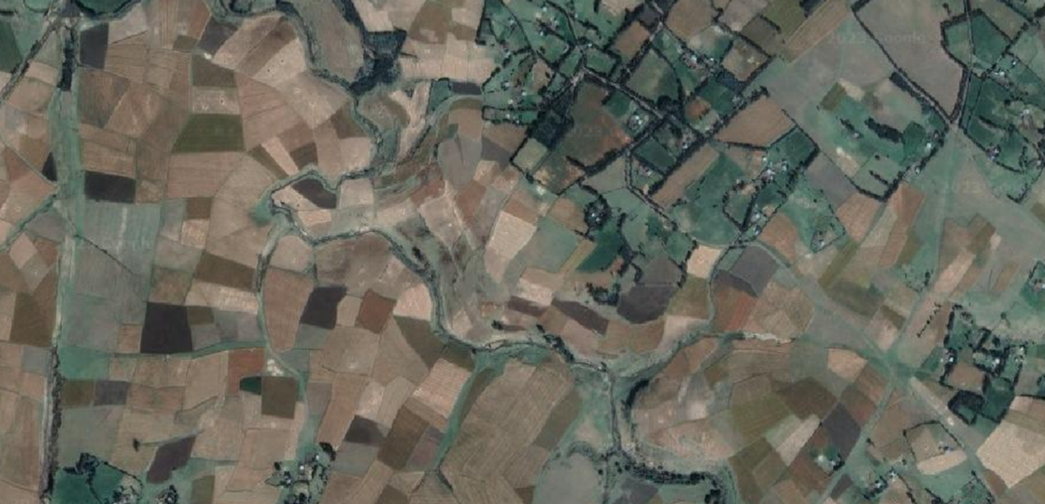
Farmer field data
GPS coordinates, water regime, variety, sowing & harvest dates, yield
Crop management (water, nutrient, pest, disease, weed), socio-economics

